Slide 1


SAP OData Training
Day - 10.

Slide 2


Agenda Day - 10
Convert Base 64 into XML
Convert XML into Base 64
Break
Q & A
Trainer: Anubhav Oberoy & Shubham Singh

Slide 3
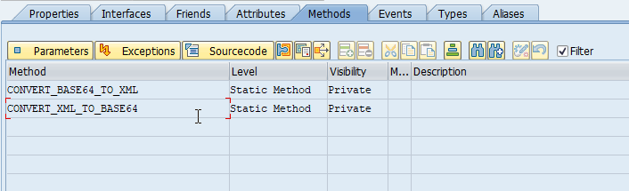
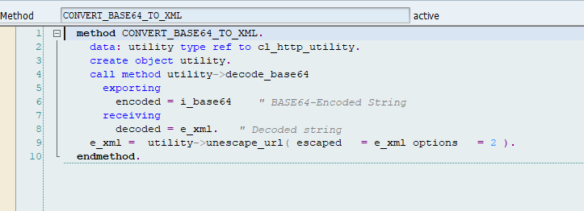
Base64
Base64 is a group of similar binary-to-text encoding schemes that represent binary data in an ASCII string format by translating it into a radix-64 representation. The term Base64 originates from a specific MIME content transfer encoding
Introduction
01
02
Hardware Innovation
Trainer: Anubhav Oberoy & Shubham Singh

Slide 4
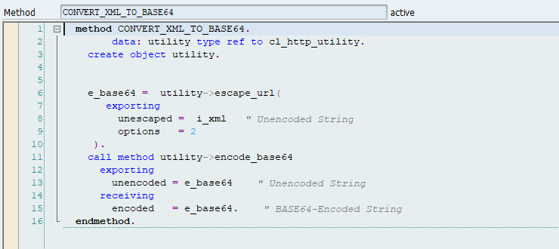
XML
XML Schema defines in a way what an XML document contains, therefore, XSD defines the string so, it can be defined as a value that contains character strings also has Unicode character given by XML and represented using the type xs: string, while this type has a white space character and maintained by the processor as ...
01
02
Hardware Innovation
Trainer: Anubhav Oberoy & Shubham Singh

Slide 5

Break

Slide 6

Questions
Trainer: Anubhav Oberoy & Shubham Singh

Slide 7

Summarize
End of Day 10

Slide 8

ANUBHAV OBEROY
www.anubhavtrainings.com
THANK YOU
“You can never leave footprints that last if you are always walking on tiptoe.”
Notes:
https://pixabay.com/photos/men-employees-suit-work-greeting-1979261/

Slide 9


We’re committed to empower you to be
Most Desirable Resource
through powerful training solutions.
We build the workforce of the future.
250+
Corporate Clients
30,000+
Learners Trained
25000+
Learners Placed
FREE WEBINARS
Sign up for free webinars with industry experts every fortnight!
Enroll Now!
Contact us today!
https://anubhavtrainings.com/

Slide 10




More from AnubhavTrainings.com

